Slide 1
CS 4900 Project Week 2
Group: 6
Michael Hayes
Ryan Slaybaugh
Semira Pinder

Slide 2
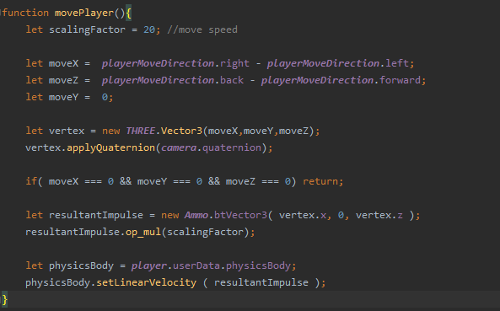
Attaching movement to Camera movement
Create a vertex with moveX, moveY, moveZ
Apply the camera’s Quaternion to the vector3.

Slide 3
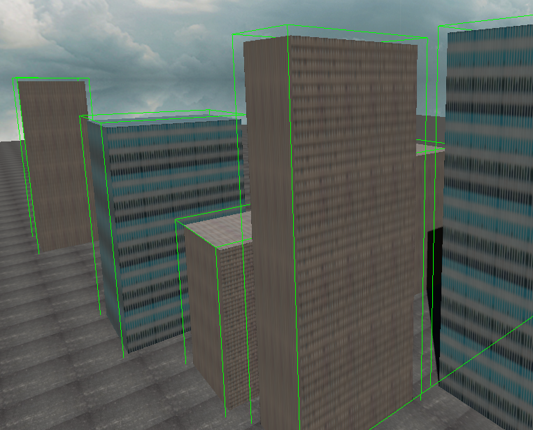
AmmoDebugDrawer.js
Extension to Ammo.js
Draws wireframe around the invisible Ammo Object.
Great for debugging collision triggers.
Exact wireframe of the Ammo Object.

Slide 4
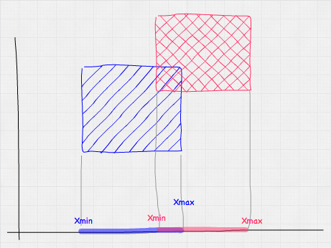
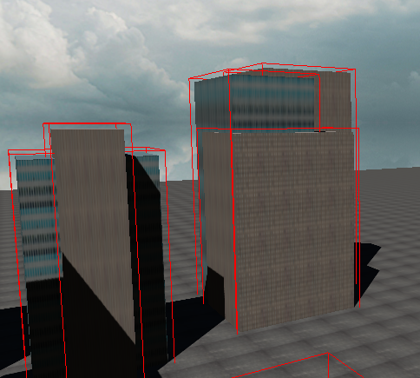
AABB(Axis Aligned Bounding Box)
It checks the coordinates of the outer edge of the bounding box to see if it is inside another bounding box.
Checks all 3 axis
if(True)
Collision

Slide 5
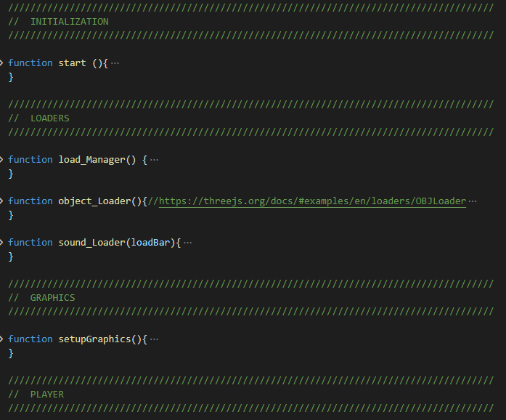
Main Menu
Code base
Separation of Menu items
Mistakes

Slide 6
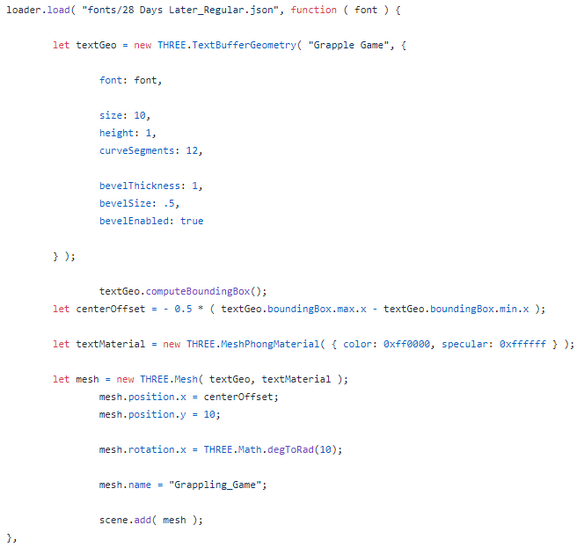
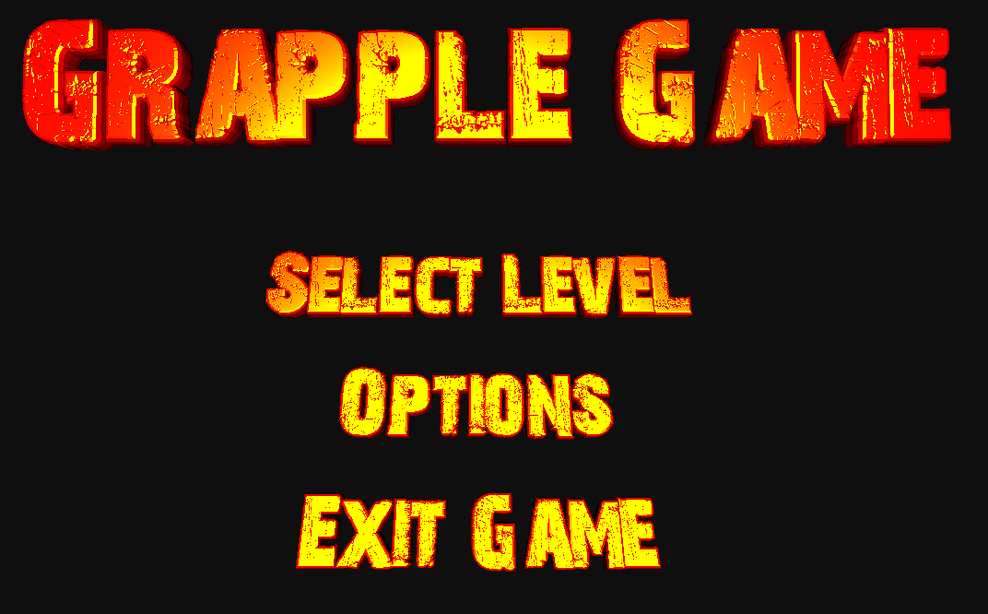
Text Creation
Text Creation
Bevel, Offset

Slide 7
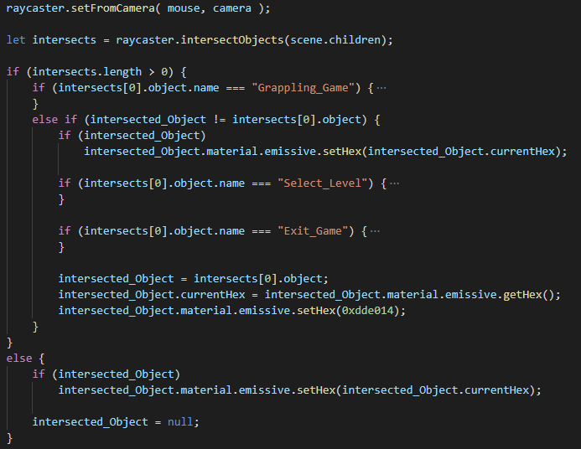
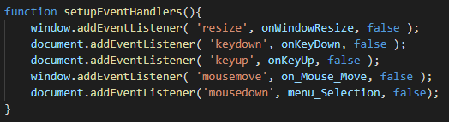

Raycasting
Raycasting Event
Implementing the Raycaster
Button Events

Slide 8
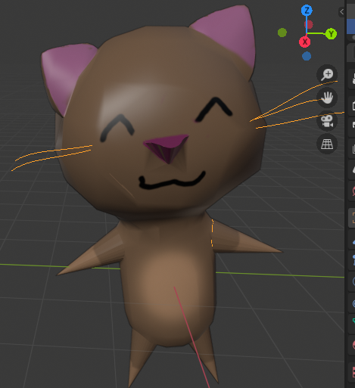
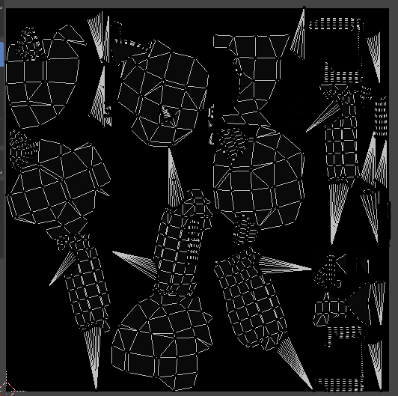
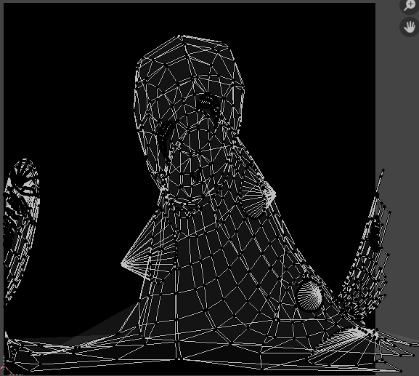
Better UV Mapping
Face context menu→ UV Unwrap faces → Smart UV Project:
Better for mapping irregular shapes compared to cube or sphere unwrap:

Slide 9
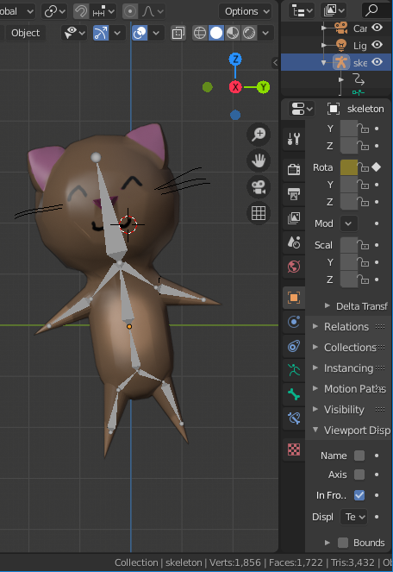
Skeleton creation
Make a new armature
Edit viewport display
Add and connect new bones
In the Parent menu, pair the mesh and the armature skeleton
Weight paint, then test

Slide 10
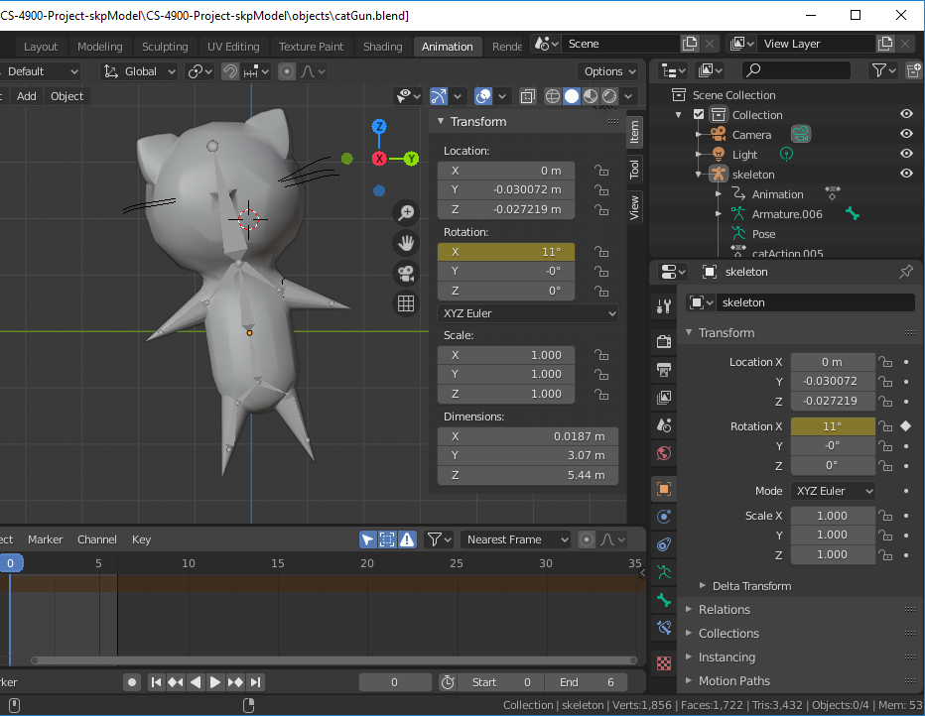
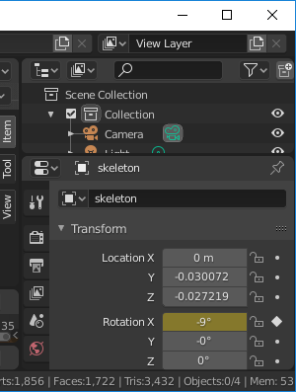
Animation
Skeleton/model transformations
Tracking transformations
Keyframes

Slide 11
Plans for next week
Refactoring
Create level 1 basic Design
Configure trigger events (game win)
Fix the catGun model and loading
Add a few animations

